Slide 1
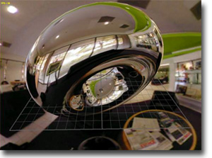
Advanced Shading Techniques
http://www.ozone3d.net/
© 2005 James K. Hahn 2010 Robert Falk

Slide 2
Shader Variations
Default OpenGL shader
Phong Illumination
Textures
Specialized Rendering
  Cartoon
  Lattice
  Cube mapping
© 2005 James K. Hahn 2010 Robert Falk

Slide 3
OpenGL Positional Lighting
Standard lighting equation for one light.
Lighting includes ambient, diffuse, and specular
Can compute values in VS and interpolate in FS or compute in FS with normals from VS.
© 2005 James K. Hahn 2010 Robert Falk

Slide 4
OpenGL Positional Lighting
Program side:
// Set up a light position and color:
glEnable(GL_LIGHT0);
// The shaders decide whether lighting is enabled or smooth
//glEnable(GL_LIGHTING);
//glShadeModel(GL_SMOOTH);
// The light position is, like a vertex, multiplied by
// the current modelview matrix.
float position[4] = {0.0f, 0.0f, 1.0f, 0.0f};
float ambient[4] = {0.2f, 0.2f, 0.2f, 1.0f};
float diffuse[4] = {0.8f, 0.8f, 0.8f, 1.0f};
float specular[4] = {1.0f, 1.0f, 1.0f, 1.0f};
glLightfv(GL_LIGHT0, GL_POSITION, pos);
glLightfv (GL_LIGHT0, GL_AMBIENT, ambient);
glLightfv(GL_LIGHT0, GL_SPECULAR, specular);
glLightfv(GL_LIGHT0, GL_DIFFUSE, diffuse);
© 2005 James K. Hahn 2010 Robert Falk

Slide 5
OpenGL Positional Lighting
More Program side:
// Set up diffuse, specular and ambient colors for the model
// Normally you would do this if there is no texture map
// Important stuff not handled in shaders:
glEnable(GL_DEPTH_TEST);
glEnable(GL_CULL_FACE);
glCullFace(GL_BACK);
float cow_diffuse[4] = {0.1f, 1.0f, 0.1f, 1.0f};
float cow_specular[4] = {1.0f, 1.0f, 1.0f, 1.0f};
  float cow_ambient[4] = {0.2f, 0.2f, 0.2f, 1.0f};
glMaterialfv(GL_FRONT, GL_DIFFUSE, cow_diffuse);
glMaterialfv(GL_FRONT, GL_SPECULAR, cow_specular);
glMaterialfv(GL_FRONT, GL_AMBIENT, cow_ambient);
glMaterialf(GL_FRONT, GL_SHININESS, 30.0f);
// Set the shader and draw the model (via glBegin/glEnd).
glUseProgram(shader_program1);
cow.draw();
© 2005 James K. Hahn 2010 Robert Falk

Slide 6
OpenGL Positional Lighting
        #version 120
        varying vec4 color;
        vec4 computeSpecular(in vec3 lightDir, in vec3 norm, in vec3 vertex_eye) {
        vec4 specular = vec4(0.0, 0.0, 0.0, 0.0);
        // GLSL reflection function: l-2.0(dot(l,norm)*norm (expects incoming light dir)
        vec3 r = reflect(-lightDir, norm);
        float VdotR = max(dot(-vertex_eye, r), 0.0);
        specular = gl_FrontMaterial.specular * gl_LightSource[0].specular *
        pow(VdotR, 20.0f);
        return specular;
        }
        void main() {
        // transform vertex into clip coords
        gl_Position = gl_ModelViewProjectionMatrix*gl_Vertex; // or: ftransform()
        // then transform the normal into eye space and normalize the result
        vec3 norm = normalize(gl_NormalMatrix * gl_Normal);
        // Transformed vertex pos. is the direction from the eye (at (0,0,0)) to the vertex
        vec3 vertex_eye = vec3(gl_ModelViewMatrix * gl_Vertex);
        // Direction to (not from) the light. Light pos. multiplied by MV matrix when set
        vec3 lightDir = normalize(gl_LightSource[0].position.xyz - vertex_eye);
        // compute diffuse factor and color
        float NdotL = max(dot(norm, lightDir), 0.0);
        vec4 diffuse = gl_FrontMaterial.diffuse * gl_LightSource[0].diffuse * NdotL;
        // Compute a local ambient term
        vec4 ambient = gl_FrontMaterial.ambient * gl_LightSource[0].ambient;
        vec4 specular = vec4(0.0, 0.0, 0.0, 0.0);
        if (NdotL > 0)
        specular = computeSpecular(lightDir, norm, vertex_eye);
        color = diffuse + specular + ambient;
        }
20
© 2005 James K. Hahn 2010 Robert Falk

Slide 7
OpenGL Positional Lighting
Fragment Shader (Gouraud shading - per vertex)
  // fragment shader- pretty simple with per-vertex lighting.
        varying vec4 color;
  void main()
  {
gl_FragColor = color;
}
© 2005 James K. Hahn 2010 Robert Falk

Slide 8
OpenGL Positional Lighting
Vertex Shader (Phong shading - per pixel)
// vertex shader:
varying vec4 diffuse, ambient;
varying vec3 normal, vertex_eye;
void main()
{
// transform the normal into eye space and normalize result
normal = normalize(gl_NormalMatrix * gl_Normal);
// Get vertex position in eye (camera) coordinates
vertex_eye = vec3(gl_ModelViewMatrix * gl_Vertex);
// Compute the diffuse, ambient and globalAmbient terms
diffuse = gl_FrontMaterial.diffuse * gl_LightSource[0].diffuse;
ambient = gl_FrontMaterial.ambient * gl_LightSource[0].ambient;
gl_Position = ftransform();
}
© 2005 James K. Hahn 2010 Robert Falk

Slide 9
OpenGL Positional Lighting
Fragment Shader (Phong shading - per pixel)
  // fragment shader-interpolate normals instead of color (phong illumination)
varying vec4 diffuse, ambient;
varying vec3 normal, vertex_eye;
  void main(void)
  {
// The ambient term will always be present
vec4 color = ambient;
// a fragment shader can't write a varying variable, hence we
// need a new variable to store the normalized interpolated normal
vec3 n = normalize(normal);
vec3 ldir = normalize(gl_LightSource[0].position.xyz - vertex_eye);
float NdotL = max(dot(n,ldir),0.0);
if (NdotL > 0.0) {
color += diffuse * NdotL;
vec3 r = reflect(-ldir, n);
float VdotR = max(dot(normalize(-vertex_eye), r), 0.0);
vec4 specular = gl_FrontMaterial.specular * gl_LightSource[0].specular *
pow(VdotR, gl_FrontMaterial.shininess);
color += specular;
}
gl_FragColor = color;
}
7
© 2005 James K. Hahn 2010 Robert Falk

Slide 10
Textures with Phong Illumination
Program side:
/***************** Initialization function *********/
// Load, compile, and link the shader
shader_program3 = createShader("../../tex1");
if (shader_program3 != 0)
{
  // Get the location of the texture, and set the texture ID to 0
GLint loc = glGetUniformLocation(shader_program3, "diffuse_tex");
glUniform1i(loc, 0);
}
/********* Display function **************************/
// Set the active shader, bind the texture and draw. Bind the
// texture to the texture unit (GL_TEXTURE{0..N}) specified when
// glUniform1i(was called)
glUseProgram(shader_program3);
glEnable(GL_TEXTURE_2D);
glActiveTexture(GL_TEXTURE0);
glBindTexture(GL_TEXTURE_2D, m_tex_id);
ball.drawTex();
© 2005 James K. Hahn 2010 Robert Falk
Notes:
The 0 and GL_TEXTURE0 refer to the texture unit.

Slide 11
Textures with Phong Illumination
Vertex Shader (Phong shading - per pixel)
// vertex shader:
varying vec4 diffuse, ambient;
varying vec3 normal, vertex_eye;
  void main()
  {
// transform the normal into eye space and normalize result
normal = normalize(gl_NormalMatrix * gl_Normal);
// Get vertex position in eye (camera) coordinates
vertex_eye = vec3(gl_ModelViewMatrix * gl_Vertex);
  // Compute the diffuse, ambient and globalAmbient terms
diffuse = gl_FrontMaterial.diffuse * gl_LightSource[0].diffuse;
ambient = gl_FrontMaterial.ambient * gl_LightSource[0].ambient;
gl_TexCoord[0] = gl_MultiTexCoord0;
gl_Position = ftransform();
}
10
© 2005 James K. Hahn 2010 Robert Falk

Slide 12
Textures with Phong Illumination
Shader side Fragment Shader (Phong shading - per pixel)
// fragment shader:
varying vec4 diffuse,ambient;
varying vec3 normal,vertex_eye;
uniform sampler2D diffuse_tex;
void main()
{
vec3 tex_color = texture2D(diffuse_tex, gl_TexCoord[0].st).rgb;
vec3 pixel = tex_color*ambient.rgb;
// the normal is linearly interpolated across the poly so we must renormalize
vec3 n = normalize(normal);
vec3 ldir = normalize(gl_LightSource[0].position.xyz - vertex_eye);
// compute the dot product between normal and light dir
float NdotL = max(dot(n,ldir),0.0);
if (NdotL > 0.0) {
pixel += tex_color * diffuse.rgb * NdotL;
vec3 r = reflect(-ldir, n);
float VdotR = max(dot(normalize(-vertex_eye), r), 0.0);
vec4 specular = gl_FrontMaterial.specular * gl_LightSource[0].specular *
pow(VdotR, gl_FrontMaterial.shininess);
pixel += specular;
}
gl_FragColor = vec4(pixel, 1.0);
}
10
© 2005 James K. Hahn 2010 Robert Falk
Notes:
Is texture2d always rgba ??

Slide 13
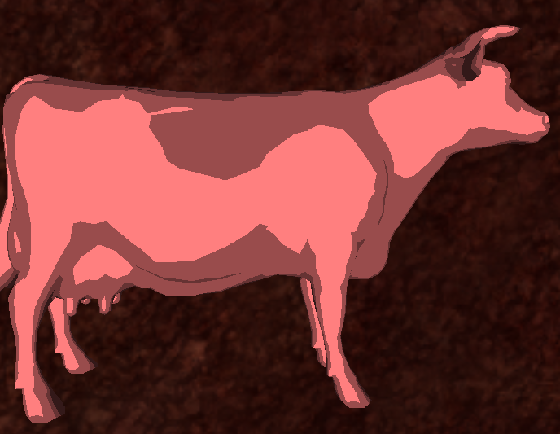
Toon Shader (solid color)
Shader uses a fixed number of shading levels
Still uses standard diffuse illumination
Program Side:
// Set up a light position:
float pos[4] = {0.0f, 0.0f, 5.0f, 1.0f};
glLightfv(GL_LIGHT1, GL_POSITION, pos);
glUseProgram(shader_program1);
cow.draw();
θ1
θ2
θ2
N
θ3
θ3
θ4
θ4
10
© 2005 James K. Hahn 2010 Robert Falk

Slide 14
Toon Shader (solid color)
Vertex Shader
varying float intensity;
void main()
{
/* first transform the normal into eye space and normalize the result */
vec3 normal = normalize(gl_NormalMatrix * gl_Normal);
// Normalize direction to light
vec3 vertex_eye = vec3(gl_ModelViewMatrix * gl_Vertex);
  vec3 lightDir = normalize(vec3(gl_LightSource[0].position.xyz - vertex_eye));
    // Send intensity to fragment shader in varying variable
intensity = max(dot(normal, lightDir), 0.0);
gl_Position = ftransform();
}
10
© 2005 James K. Hahn 2010 Robert Falk

Slide 15
Toon Shader (solid color)
Fragment Shader
varying float intensity;
void main()
{
vec4 color;
  // Hard code 4 possible light levels based on dot(N,L). Could pick any
  // number of levels, or pass in the number of levels and use a for-loop.
if (intensity > 0.85)
color = vec4(1.0,0.5,0.5,1.0);
else if (intensity > 0.5)
color = vec4(0.6,0.3,0.3,1.0);
else if (intensity > 0.25)
color = vec4(0.4,0.2,0.2,1.0);
else
color = vec4(0.2,0.1,0.1,1.0);
gl_FragColor = color;
}
http://en.wikibooks.org/wiki/GLSL_Programming/Unity/Toon_Shading
10
© 2005 James K. Hahn 2010 Robert Falk

Slide 16
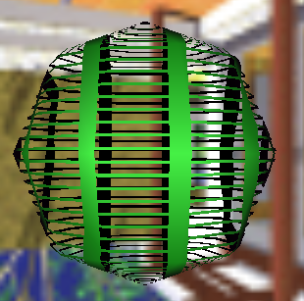
Lattice Shader (solid color)
Vertex Shader
varying vec3 color;
void main() // Standard lighting calculations...
{
color = vec3(0.0, 0.0, 0.0);
// Vertex position in eye coords
vec3 ec_position = vec3(gl_ModelViewMatrix * gl_Vertex);
// Transform normal into eye space
vec3 tnorm = normalize(gl_NormalMatrix * gl_Normal);
vec3 light_dir = normalize(gl_LightSource[0].position.xyz - ec_position);
vec3 view_vec = -normalize(ec_position);
vec3 r = reflect(-light_dir, tnorm);
float VdotR = max(dot(view_vec, r), 0.0);
vec3 specular = vec3( gl_FrontMaterial.specular * gl_LightSource[0].specular ) *
pow(VdotR, 1.0);
vec3 ambient = vec3(gl_FrontMaterial.ambient * gl_LightSource[0].ambient);
float NdotL = abs(dot(tnorm, light_dir));
vec3 diffuse = ambient+(gl_FrontMaterial.diffuse*gl_LightSource[0].diffuse).rgb * NdotL;
gl_TexCoord[0] = gl_MultiTexCoord0;
gl_Position = ftransform();
}
10
© 2005 James K. Hahn 2010 Robert Falk
Notes:
The astute observer will see that we are doing gouraud shading here with the only addition being to pass
the texture coordinate on to the fragment shader. Makes the fragment shader “cleaner” so we can focus on the lattice shader aspects there.

Slide 17
Lattice Shader (solid color)
Fragment Shader
varying vec3 color;
void main()
{
  // Scale is number of times drop-out bands will repeat
  // over texture range 0..1 (number of bands in s,t)
vec2 scale = vec2(5.0, 35.0);
// threshold is % visible vs. dropout in each band (0..1)
vec2 threshold = vec2(0.23, 0.23);
// Remember texture coords go from (0,0) to (1,1).
// discard any pixels when the fractional component
// of the texture coord * scale > threshold, e.g.
// tex_coord=(0.41, 0.2), ss=fract(0.41*5)=0.05, 0.05<0.23 => keep.
float ss = fract(gl_TexCoord[0].s * scale.s);
float tt = fract(gl_TexCoord[0].t * scale.t);
if ((ss>threshold.s) && (tt>threshold.t)) discard;
  // If we pass that test, normal Gouraud shading
gl_FragColor = vec4(color, 1.0);
}
10
© 2005 James K. Hahn 2010 Robert Falk

Slide 18
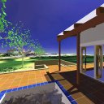
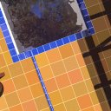
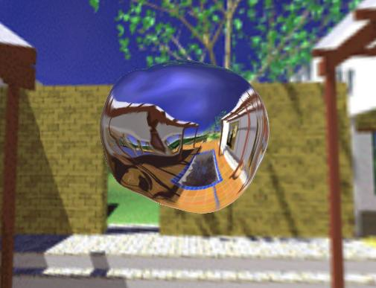
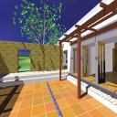
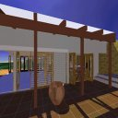
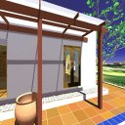
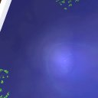
Cube Map Shader
http://developer.nvidia.com/object/cube_map_ogl_tutorial.html
6 images can be pre-created or taken each frame
© 2005 James K. Hahn 2010 Robert Falk

Slide 19
Cube Map Shader
Take six images of the environment as they would project onto the faces of a cube
Create a single OpenGL cube texture (GL_TEXTURE_CUBE_MAP )
In fragment shader use textureCube() with the reflection direction r to look up pixel.
How does textureCube find a pixel?
  take major vector direction max(r.x,r.y,r.z)
  pick texture along that axis, + or - direction
  set the s,t coordinates to the other 2 axes each scaled by dividing by primary axis.
© 2005 James K. Hahn 2010 Robert Falk
Notes:
Need to pick 1 of six images (0.7, 0.4 0.5) - 6 options (largest +/- x ...)
Get (s,t) as ((0.4/(abs(x))+1)/2, ((0.5/(abs(x)) +1)/2. Note that these will range from 0..1.
(the 0.4, 0.5 may be negated based on direction

Slide 20
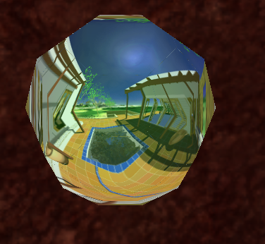
Cube Map Shader
Program (C++) side
// Load the shader:
GLuint g_cube_shader = createShader("cube");
GLint g_cube_camera_loc = -1;
GLuint g_cube_tex_id;
if (g_cube_shader > 0) {
cube_tex_loc = glGetUniformLocation(g_cube_shader, "cube_tex");
glUniform1i(cube_tex_loc, 0);
g_cube_camera_loc = glGetUniformLocation(g_cube_shader, "camera_pos");
}
// Load the 6 texture maps. When loading images, they should be flipped along
// the y axis relative to normal OpenGL texture orientation since they match
// the RenderMan cubemap specification.
glEnable(GL_TEXTURE_CUBE_MAP);
glGenTextures(1, &g_cube_tex_id);
glBindTexture(GL_TEXTURE_CUBE_MAP, g_cube_tex_id);
// Attach the 6 cube map images to the current texture id ‘g_cube_tex_id’
loadCubeMap();
21
10
© 2005 James K. Hahn 2010 Robert Falk

Slide 21
void loadCubeMap()
{
glPixelStorei(GL_UNPACK_ALIGNMENT, 1);
GLenum cubefaces[6]={GL_TEXTURE_CUBE_MAP_POSITIVE_X, GL_TEXTURE_CUBE_MAP_NEGATIVE_X,
GL_TEXTURE_CUBE_MAP_POSITIVE_Y, GL_TEXTURE_CUBE_MAP_NEGATIVE_Y,
GL_TEXTURE_CUBE_MAP_POSITIVE_Z, GL_TEXTURE_CUBE_MAP_NEGATIVE_Z };
std::string cube_tex[6] = { "cm_left.png", "cm_right.png", "cm_top.png",
        "cm_bottom.png", "cm_back.png", "cm_front.png"};
for (int i = 0; i < 6; i++) {
int texformat;
unsigned int width, height;
  // Read an image file and return its bytes in “image_data”. In returned image
  // data byte image_data[0] should be upper left corner (not flipped like other
  // opengl textures). glTexImage2D then adds the image to current g_cube_tex_id.
unsigned char* image_data = getImageDataFromFile(
      cube_tex[i].c_str(), texformat, width, height);
glTexImage2D(cubefaces[i], 0, texformat, width, height, 0,
      texformat, GL_UNSIGNED_BYTE, image_data);
}
glTexParameteri(GL_TEXTURE_CUBE_MAP, GL_TEXTURE_WRAP_S, GL_CLAMP_TO_EDGE);
glTexParameteri(GL_TEXTURE_CUBE_MAP, GL_TEXTURE_WRAP_T, GL_CLAMP_TO_EDGE);
glTexParameteri(GL_TEXTURE_CUBE_MAP, GL_TEXTURE_WRAP_R, GL_CLAMP_TO_EDGE);
glTexParameteri(GL_TEXTURE_CUBE_MAP, GL_TEXTURE_MAG_FILTER, GL_LINEAR);
glTexParameteri(GL_TEXTURE_CUBE_MAP, GL_TEXTURE_MIN_FILTER, GL_LINEAR);
}
© 2005 James K. Hahn 2010 Robert Falk

Slide 22
Program (C++) side (draw function)
glMatrixMode(GL_PROJECTION);
glLoadIdentity();
gluPerspective(50.0, viewport_width/viewport_height, 0.05, 200);
// Add view matrix to projection matrix for cube mapping
gluLookAt(m_eye_pos.x(), m_eye_pos.y(), m_eye_pos.z(),
m_eye_pos.x()+m_look_dir.x(), m_eye_pos.y()+
m_look_dir.y(), m_eye_pos.z() +m_look_dir.z(), 0.0, 1.0, 0.0);
// Do modelview matrix as a model matrix instead:
glMatrixMode(GL_MODELVIEW);
glLoadIdentity();
//Set light in world coordinates for cube mapping
glLightfv(GL_LIGHT0, GL_POSITION, position1);
drawRoom();
glUseProgram(g_cube_shader);
  glUniform3f(g_cube_camera_loc, m_eye_pos.x(), m_eye_pos.y(), m_eye_pos.z());
glEnable(GL_TEXTURE_CUBE_MAP);
glActiveTexture(GL_TEXTURE0);
glBindTexture(GL_TEXTURE_CUBE_MAP, g_cube_tex_id);
ball.draw();
© 2005 James K. Hahn 2010 Robert Falk

Slide 23
Cube Map Shader
Vertex Shader
varying float intensity;
varying vec3 normal, eyedir;
uniform vec3 camera_pos;
void main()
{
// transform the normal into eye space and normalize result
// but for cubemap comp, we want world space)
normal = normalize(gl_NormalMatrix * gl_Normal);
// Should use model matrix (world space) not modelview
vec3 vertex_pos = vec3(gl_ModelViewMatrix * gl_Vertex);
eyedir = normalize(vertex_pos - camera_pos);
vec3 light_dir = normalize(gl_LightSource[0].position.xyz - vertex_pos);
intensity = max(dot(light_dir, normal), 0.0);
gl_Position = ftransform();
}
10
© 2005 James K. Hahn 2010 Robert Falk

Slide 24
Cube Map Shader
Fragment Shader
varying float intensity;
varying vec3 normal, eyedir;
uniform samplerCube cube_tex;
void main()
{
vec3 n = normalize(normal);
vec3 ed = normalize(eyedir);
vec3 rd = reflect(ed, n);
// Look up cube map reflection from 6 textures:
vec3 env_color = vec3(textureCube(cube_tex, rd));
// Mix in the base (underlying) color, if any:
vec3 base = vec3(intensity*gl_FrontMaterial.diffuse);
env_color = mix(env_color, base, 0.2);
gl_FragColor = vec4(env_color, 1.0);
}
20
10
© 2005 James K. Hahn 2010 Robert Falk

Slide 25

Next: More Advanced Shading Techniques
© 2005 James K. Hahn 2010 Robert Falk

